Slide 1
Strategically Closing the Digital Divide
James Wells
Director : Digital Innovation & Support
Middlesbrough College

Slide 2
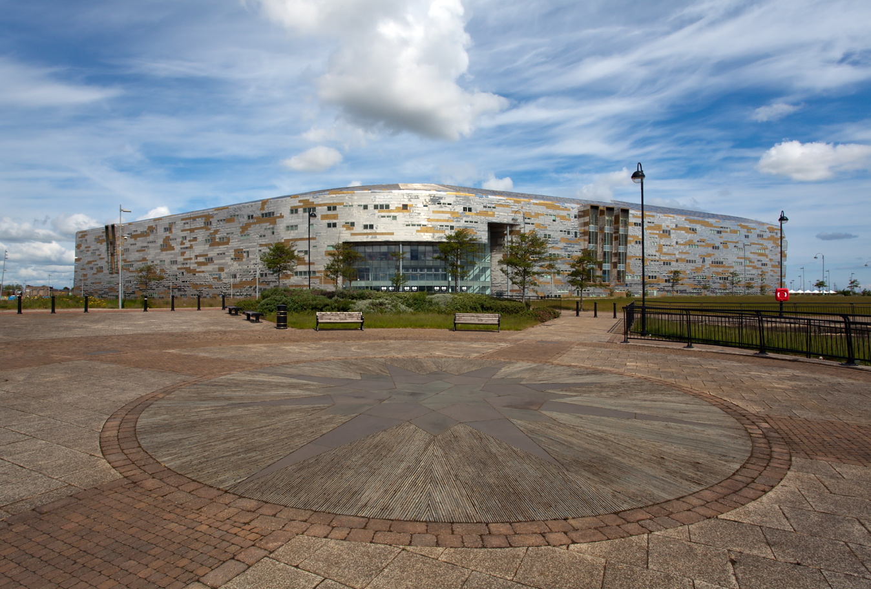

Slide 4
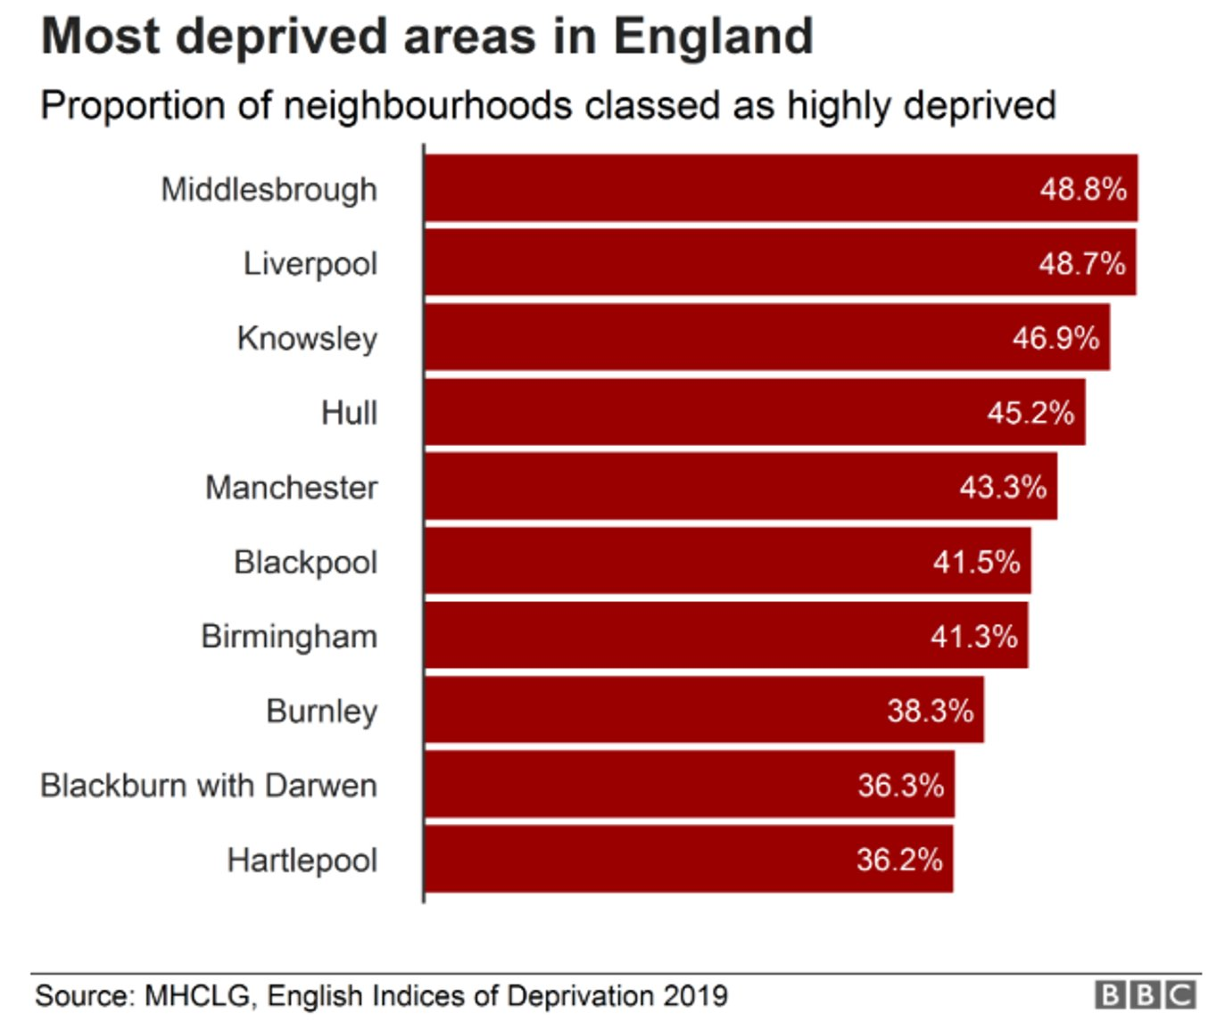
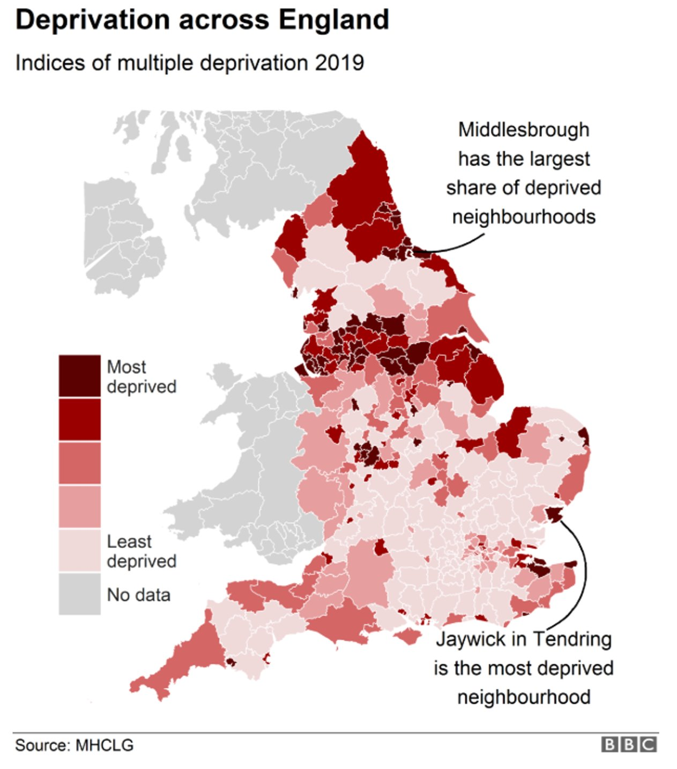

Slide 5
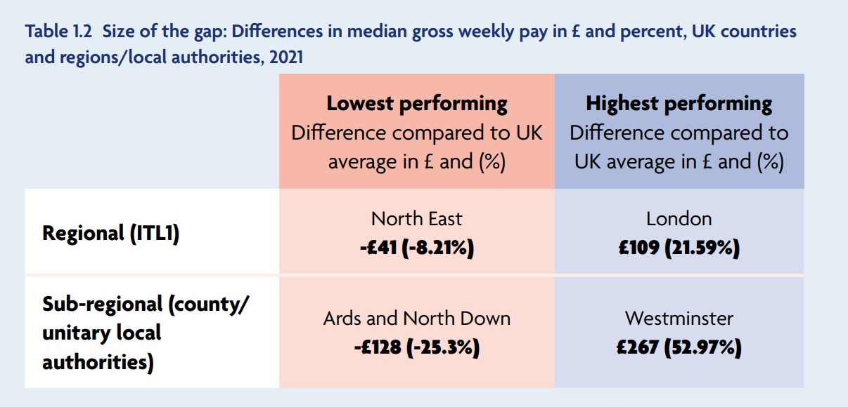

Slide 6
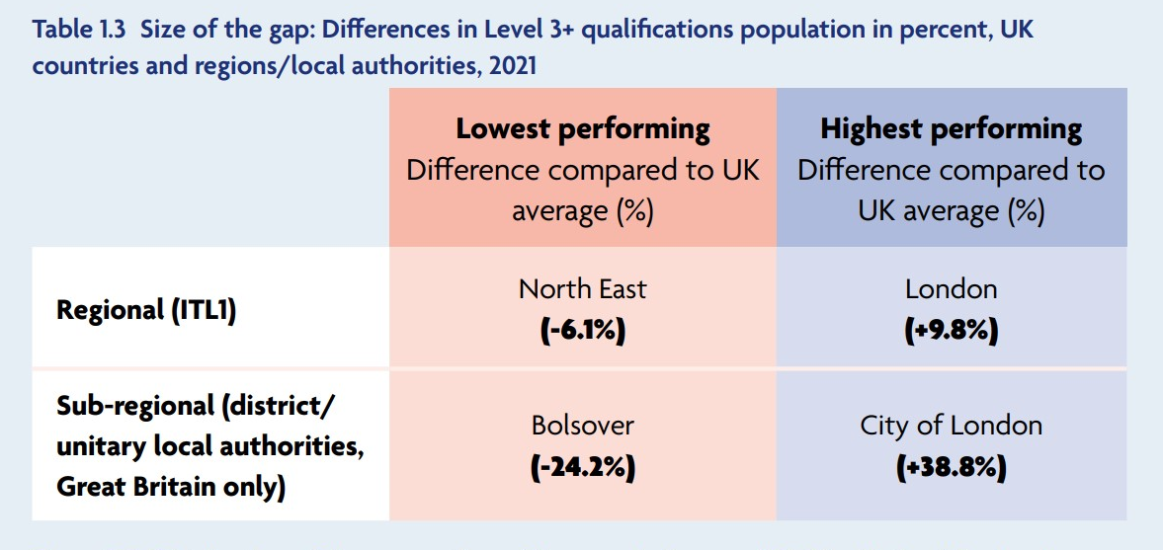

Slide 7
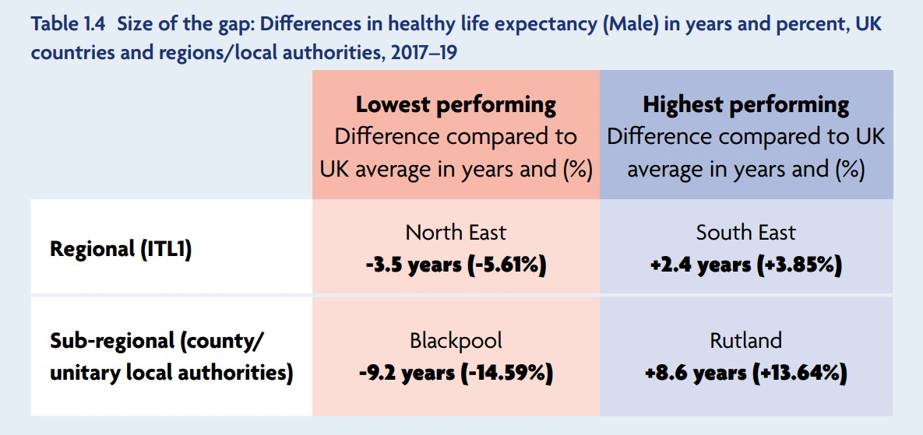

Slide 9
Digital Inadequacies
Inequality of access
Inequality of digital skills
MC Click
Systems not optimised
Notes:
RS

Slide 11
Digital Inadequacies
Inequality of access
Inequality of digital skills
MC Click
Systems not optimised
Notes:
RS

Slide 12
Digital Strategy?
Notes:
JW

Slide 13
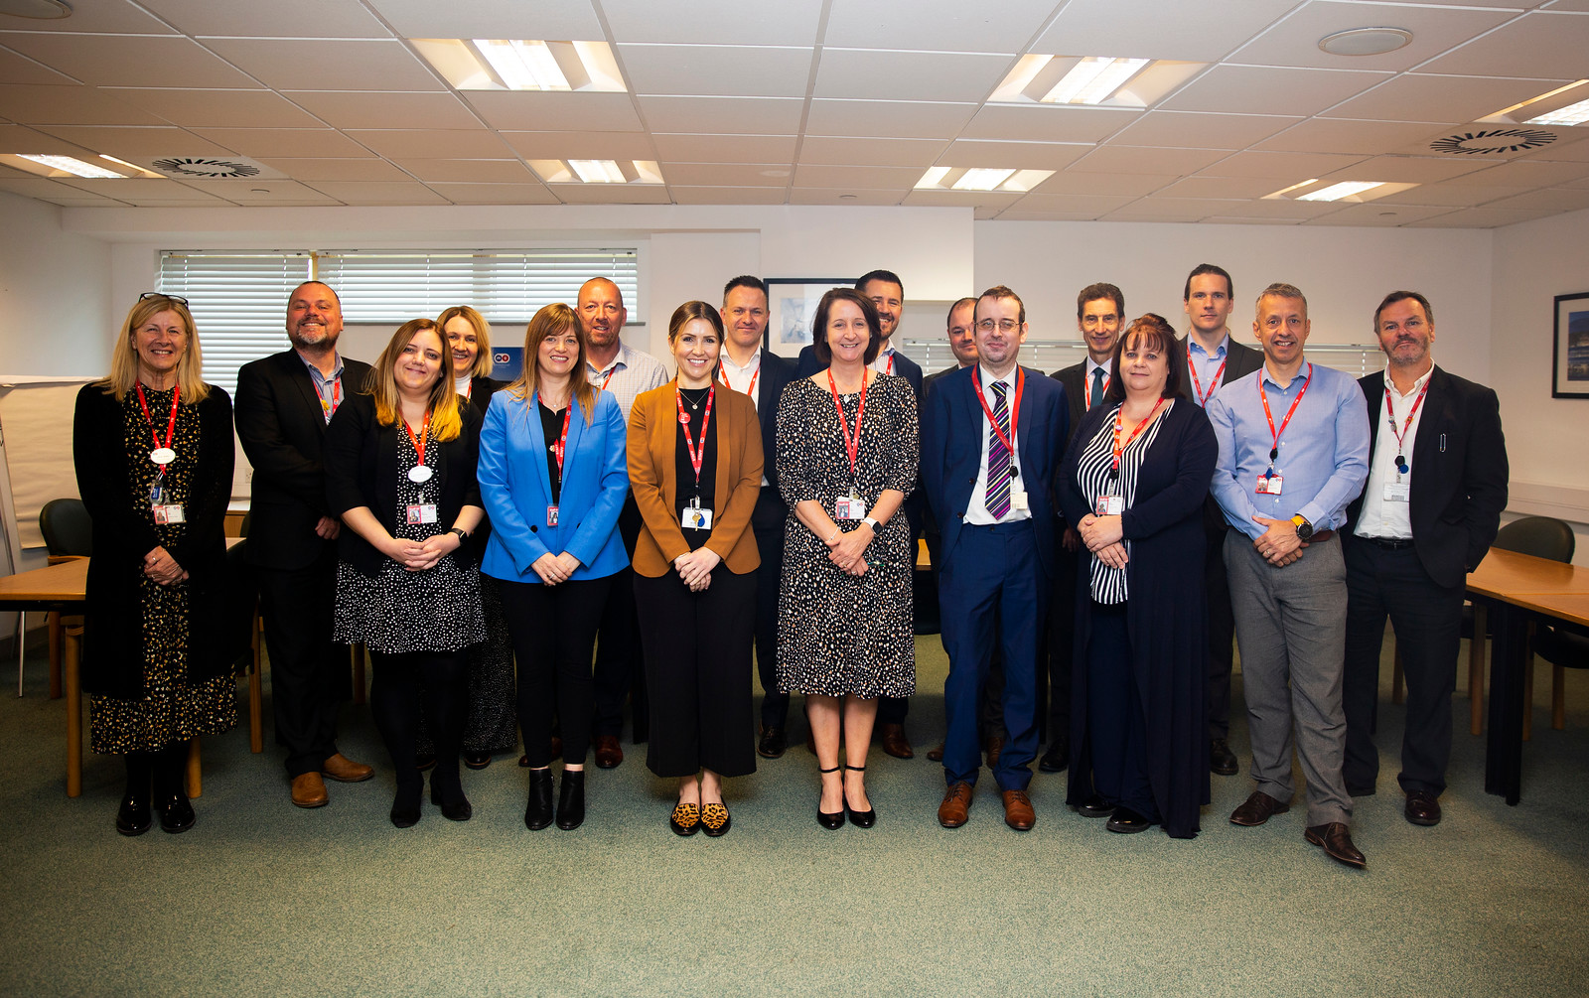
CMT Consultation
Notes:
JW

Slide 14
Staff Consultation
Notes:
JW

Slide 15
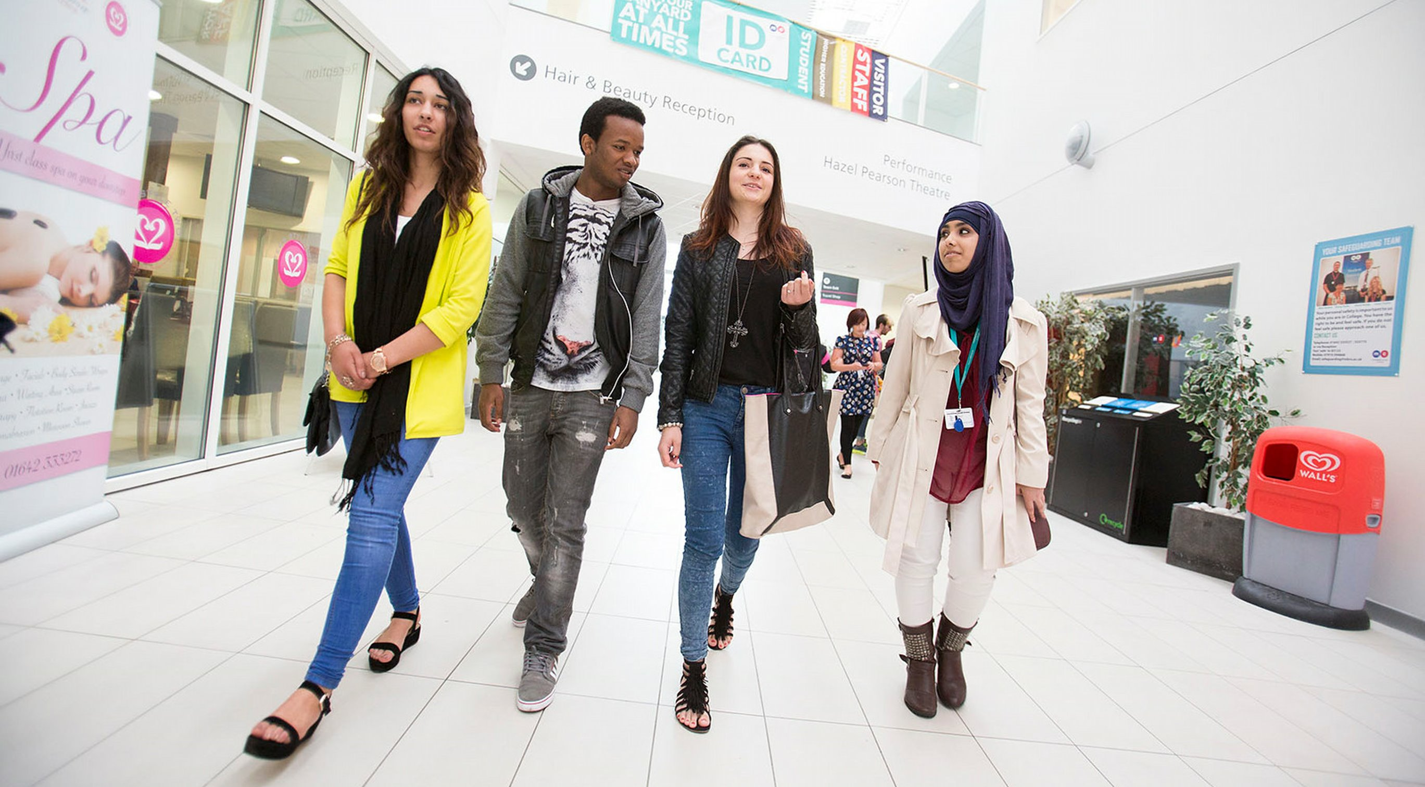
Learner Consultation
Notes:
JW

Slide 16
Key Findings
A move to 1-1 personal devices for learners
Continue to upskill all staff in order to support learners and work more productively
More adaptable learning and office spaces which can be configured based on need
Increased online support for learners, possibly 24/7
The necessity of reliable and good quality Wi-fi available everywhere
The need for a VLE Review / move to a single platform
Removal / improvement of the VDI
Onboarding digital initiative for learners
Keep combination of on-site and online teaching practice, dependent on level
Remote access to all lessons / content for those absent
Keyless access to rooms / auto marking of registers
Move to a paperless / digital campus
Some continued flexible working but in a manged way

Slide 17
How do you visualise your classroom / IT layouts within college changing in the future?
"1-1 portable devices available for all learners which would promote digital accessibility and equity. This would allow for a much more flexible and adaptable learning and working environment, easing current timetabling intricacies and ensure each classroom is fit for purpose no matter what lesson is taking place".

Slide 18
How do you visualise your classroom / IT layouts within college changing in the future?
“All students should be using the same type of device so that there is no disparity in their learning experience".

Slide 19
Digital Inadequacies
Inequality of access
Inequality of digital skills
MC Click
Systems not optimised
Notes:
RS

Slide 20
Digital Requirements
Improved access to digital
Improved training and support
MC Click
Fewer, more intuitive systems
Notes:
RS

Slide 21
2021 – 2025 Digital Transformation Strategy
Equality and digital accessibility for all learners
Innovative digital education
Enhanced business productivity
Highly employable learners
Digital upskilling
Leadership advocates
Technology enhanced learning
Business improvement thinking
Ongoing personal development
Digital champions
Digital rewards
TRANSFORMATION
PEOPLE
Cloud based
Seamless teaching systems
Intuitive mobile access
Single sign-on
Dynamic software solutions
Paper-less business systems
Single data portals
Resilience
WiFi connectivity
Cloud technology
Excellent service and support
Disaster recovery
Cyber safety
Internet everywhere
Devices for all
SYSTEMS
FOUNDATION

Slide 22
2021 – 2025 Digital Transformation Strategy
Equality and digital accessibility for all learners
Highly employable learners
Enhanced business productivity
Innovative digital education
Digital upskilling
Leadership advocates
Technology enhanced learning
Business improvement thinking
Ongoing personal development
Digital champions
Digital rewards
TRANSFORMATION
PEOPLE
Cloud based
Seamless teaching systems
Intuitive mobile access
Single sign-on
Dynamic software solutions
Paper-less business systems
Single data portals
Resilience
WiFi connectivity
Cloud technology
Excellent service and support
Disaster recovery
Cyber safety
Internet everywhere
Devices for all
SYSTEMS
FOUNDATION
Notes:
JW

Slide 23
Transformation
Equality and digital accessibility for all learners
Highly employable learners
Enhanced business productivity
Innovative digital education

Slide 24
Accessibility
Access to hardware
Access to software
Accessible for all needs
Notes:
JW

Slide 25
Highly Employable Learners
Industry-standard platforms
Improved digital skills
MC Click
Work-ready skills
Notes:
JW

Slide 26
Work-ready Skills
Notes:
RS

Slide 27
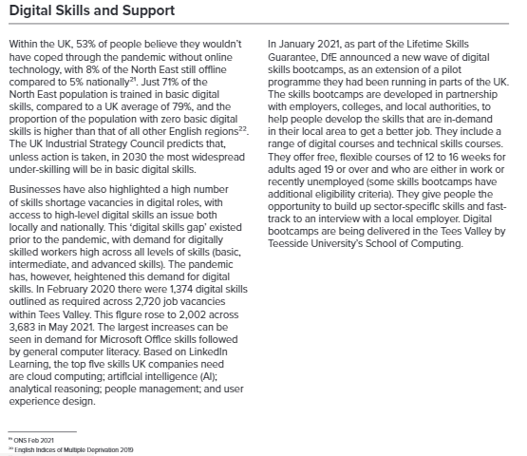
Work-ready Skills
Notes:
RS

Slide 28
Work-ready Skills
Notes:
RS

Slide 29
Work-ready Skills
"...The largest increases can be seen in demand for Microsoft Office skills followed by general computer literacy..."
Notes:
RS

Slide 30
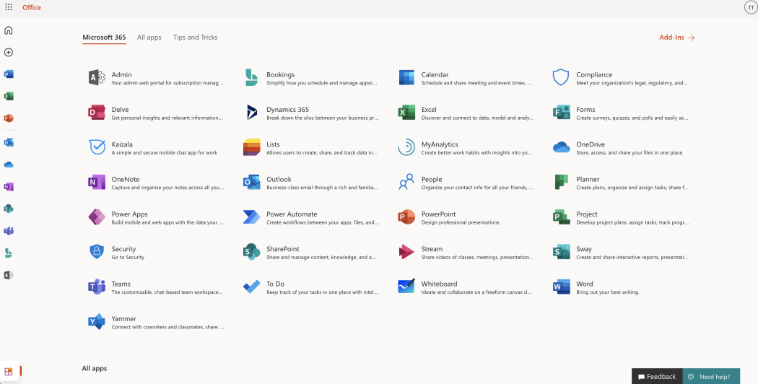
Enhanced Productivity
Redefining Processes
Cloud Access
MC Click
Integrated Systems
Notes:
JW

Slide 31
Innovative Education
Deeper understanding
Instant, personalised feedback
Improved collaboration & comms
Immersive, engaging experiences
MC Click
Data-driven interventions
Notes:
JW

Slide 32
Transformation
Equality and digital accessibility for all learners
Highly employable learners
Enhanced business productivity
Innovative digital education

Slide 33
Progress
Notes:
JW

Slide 34
Digital Requirements
Improved access to digital
Improved training and support
MC Click
Fewer, more intuitive systems
Notes:
RS

Slide 35
Digital Requirements
Improved access to digital
Improved training and support
MC Click
Fewer, more intuitive systems
Notes:
RS

Slide 38
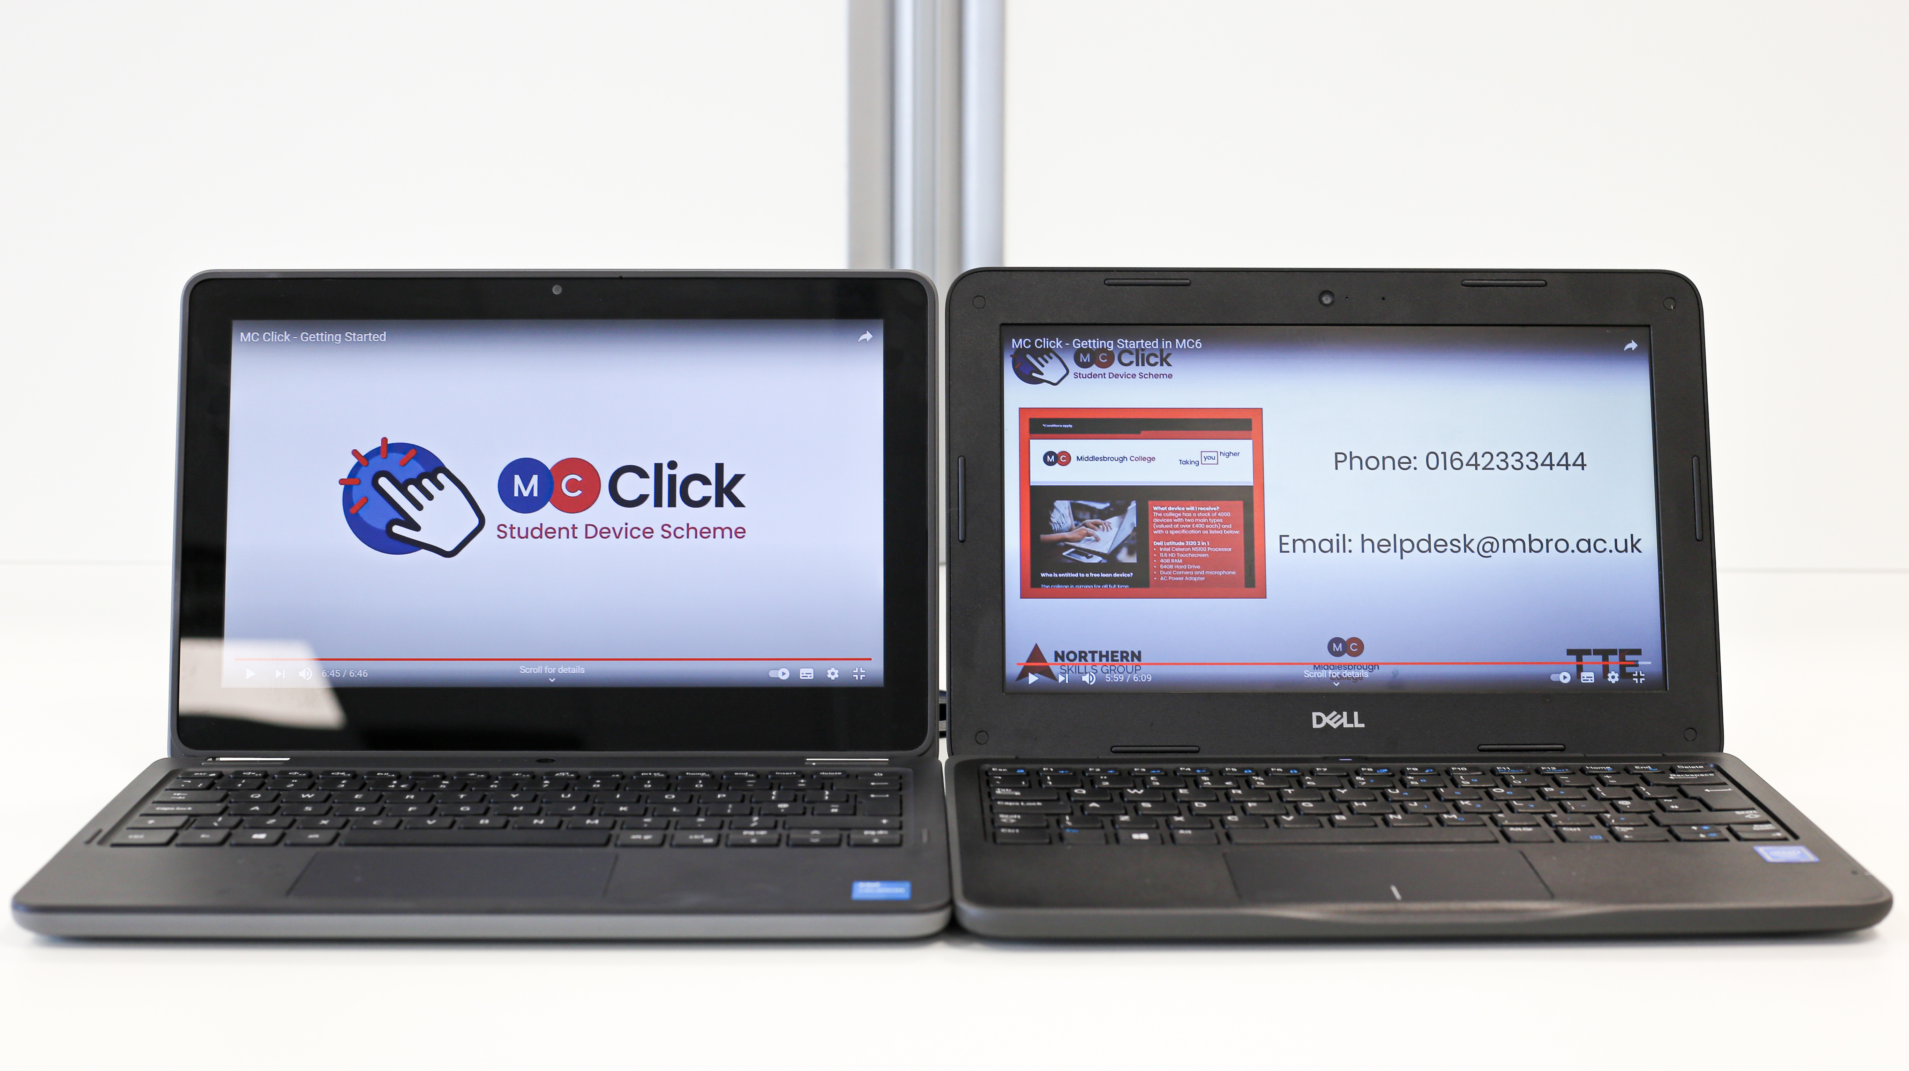

Slide 39
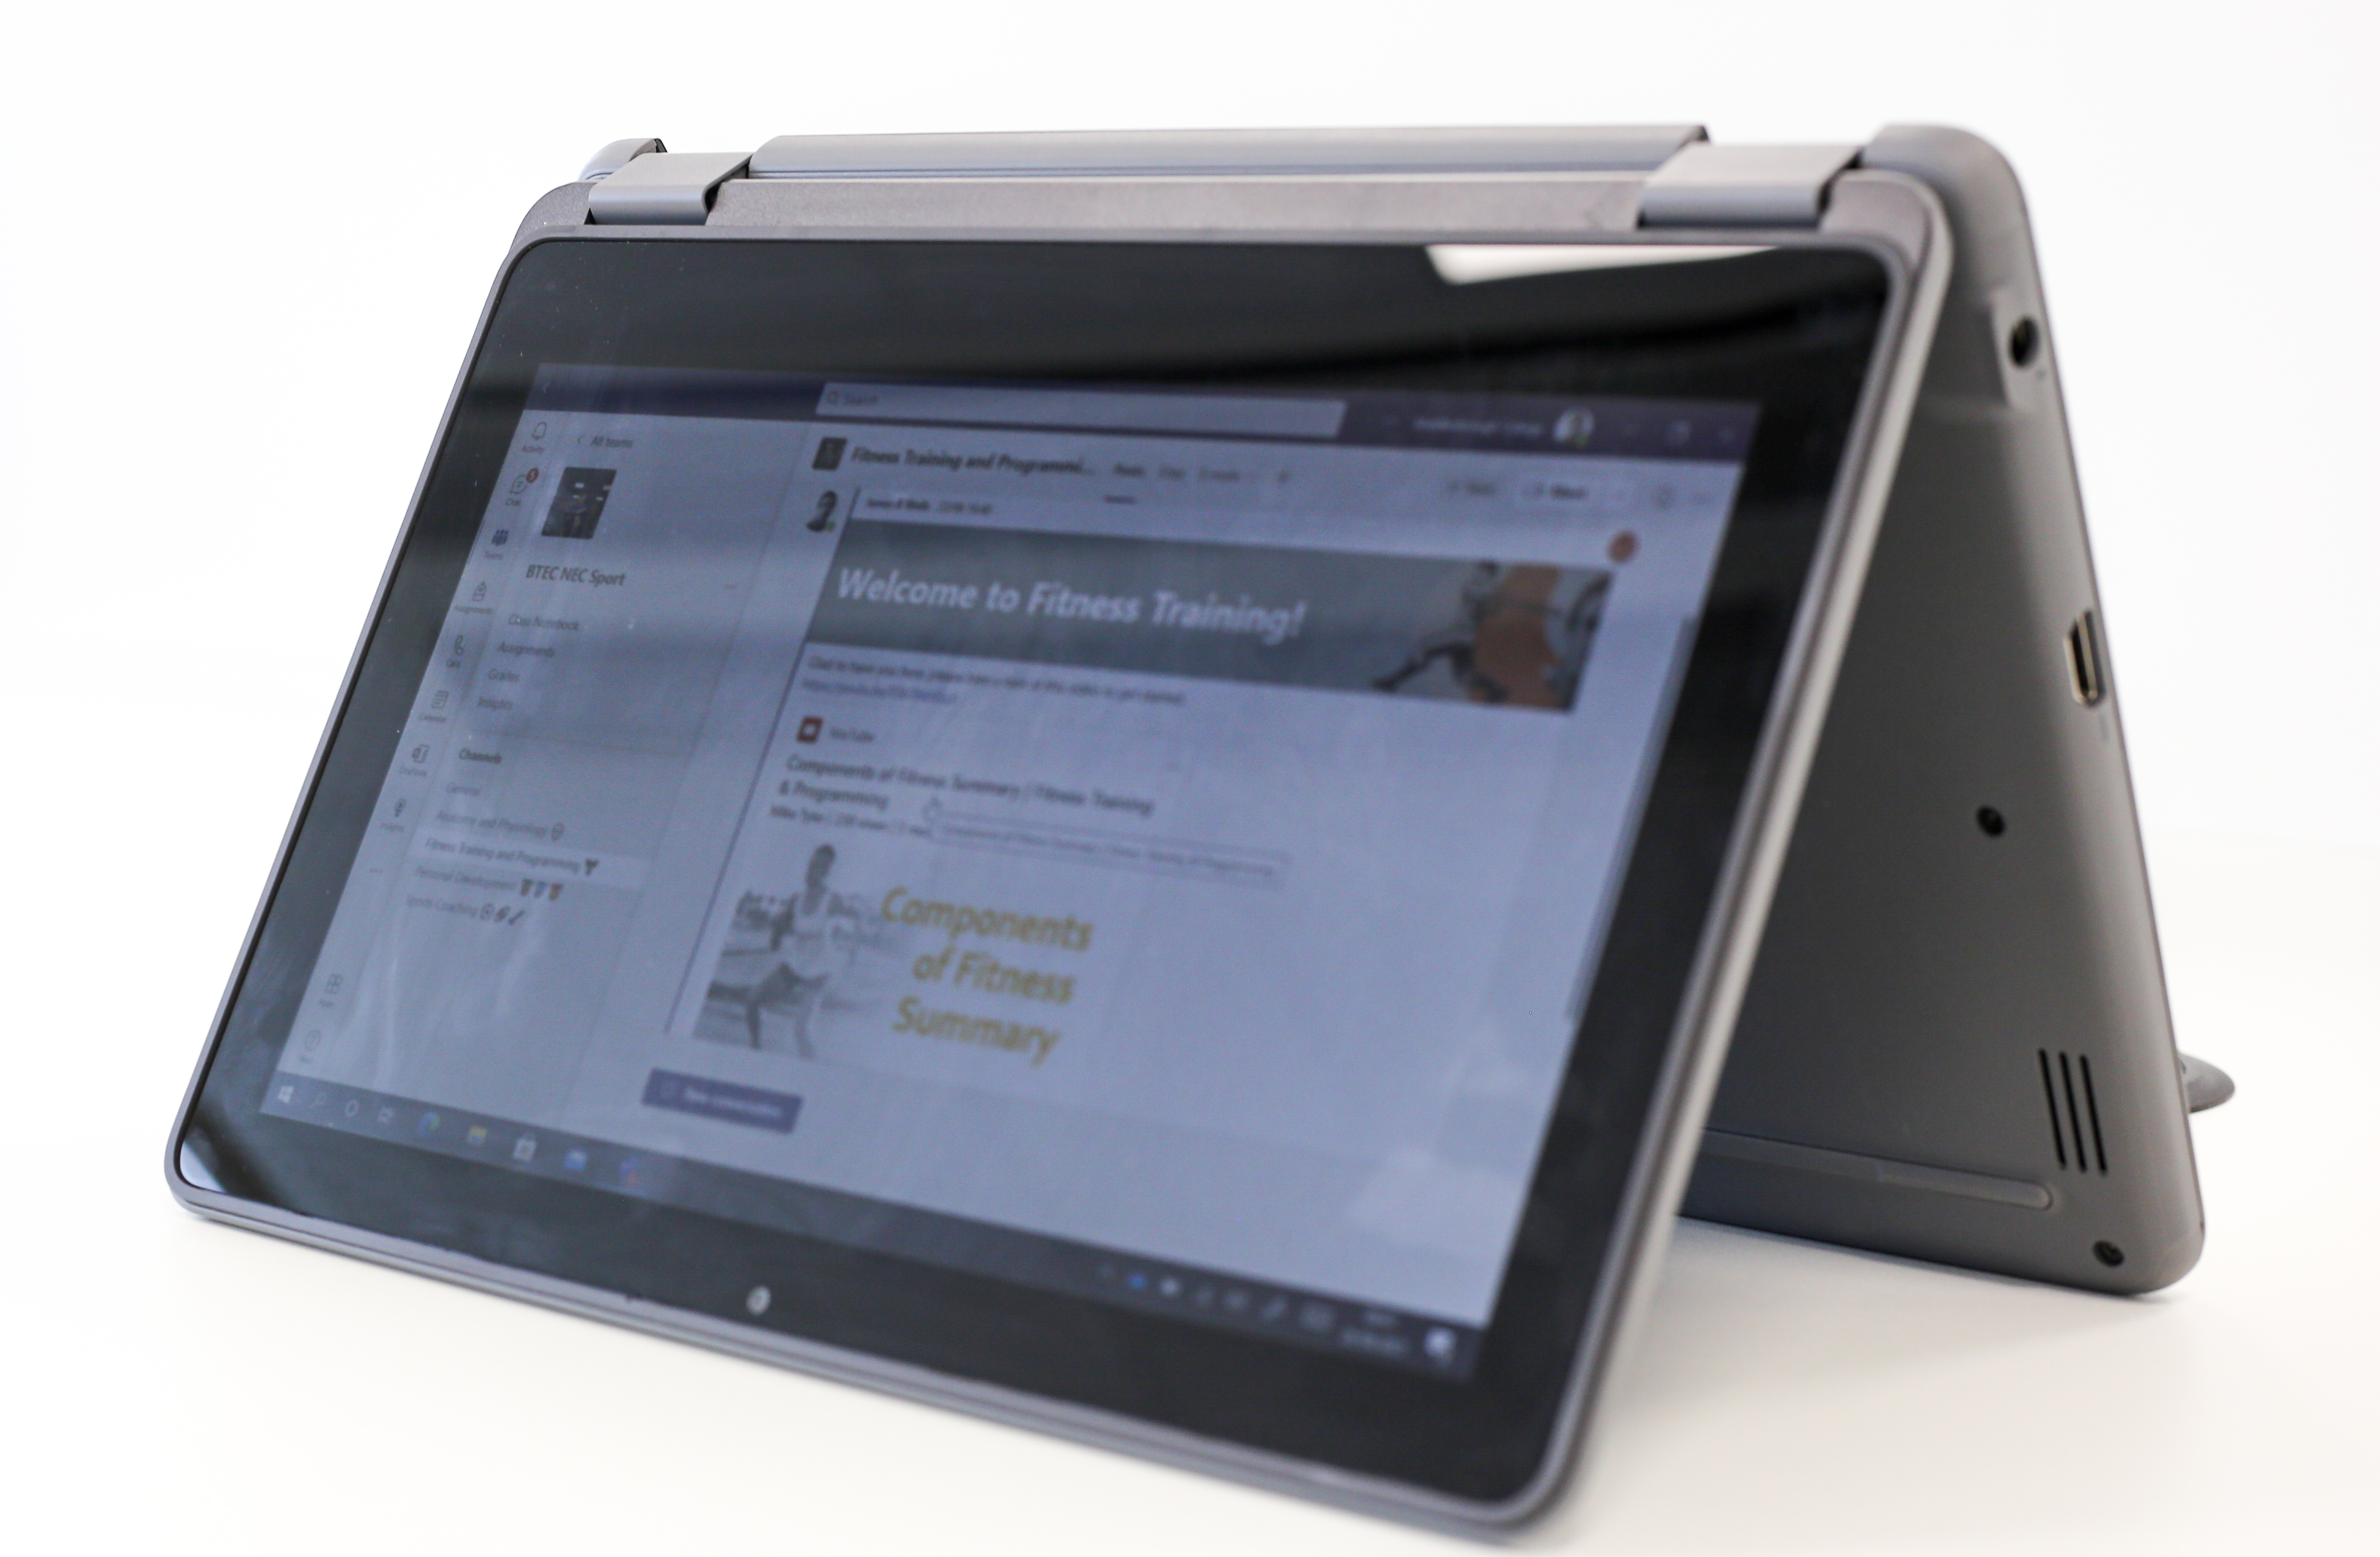

Slide 40
Academic Year | 2021/22 ​ | 2022/23​ | 2023/24
Devices | 3639 | 4500 | 5500
Capital Investment | ​£2 million | £1 million | £1 million ​
MC Click
Notes:
RS

Slide 41
Devices for all*
Overview: 3639 1-1 devices deployed
Impact: 90% agreed benefitted T & L
MC Click
Challenges: Equity & Infrastructure
Notes:
RS

Slide 42
Digital Requirements
Improved access to digital
Improved training and support
MC Click
Fewer, more intuitive systems
Notes:
RS

Slide 43
Digital Upskilling
Overview: Staff & Learner Digital CPD embedded
Impact: All students and over 600 staff engaged
MC Click
Challenges: Streamline process & analytics
Notes:
RS

Slide 45
Digital Upskilling
MC Click
Notes:
RS

Slide 46
Notes:
RS

Slide 47
Notes:
RS

Slide 48
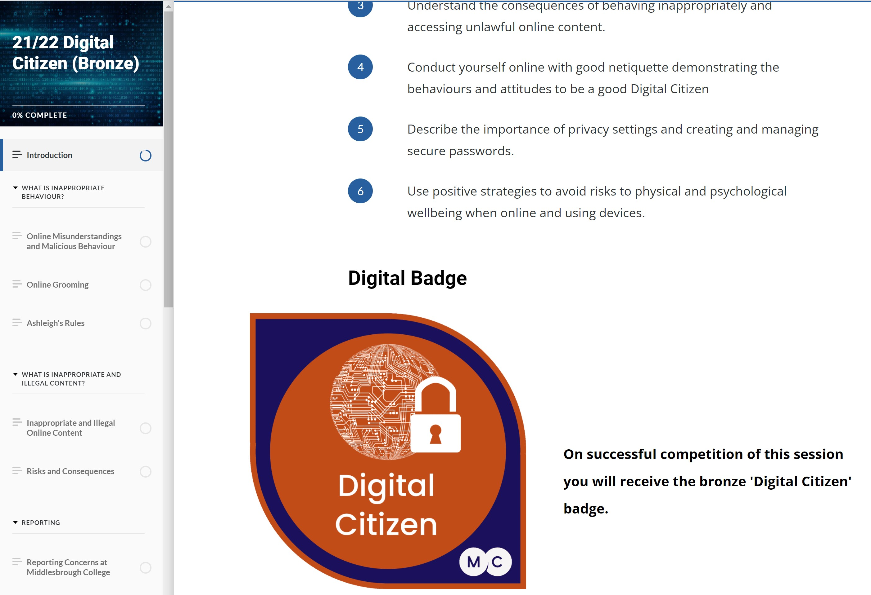
Digital Upskilling
Notes:
RS

Slide 49
Digital Upskilling
Overview: Staff & Learner Digital CPD embedded
Impact: All students and over 600 staff engaged
MC Click
Challenges: Streamline process & analytics
Notes:
RS

Slide 50
Improved Support
Overview: Implemented Digital Coaches & Help Centre
Impact: 24/7 digital assistance
MC Click
Challenges: Further investment
Notes:
RS

Slide 51
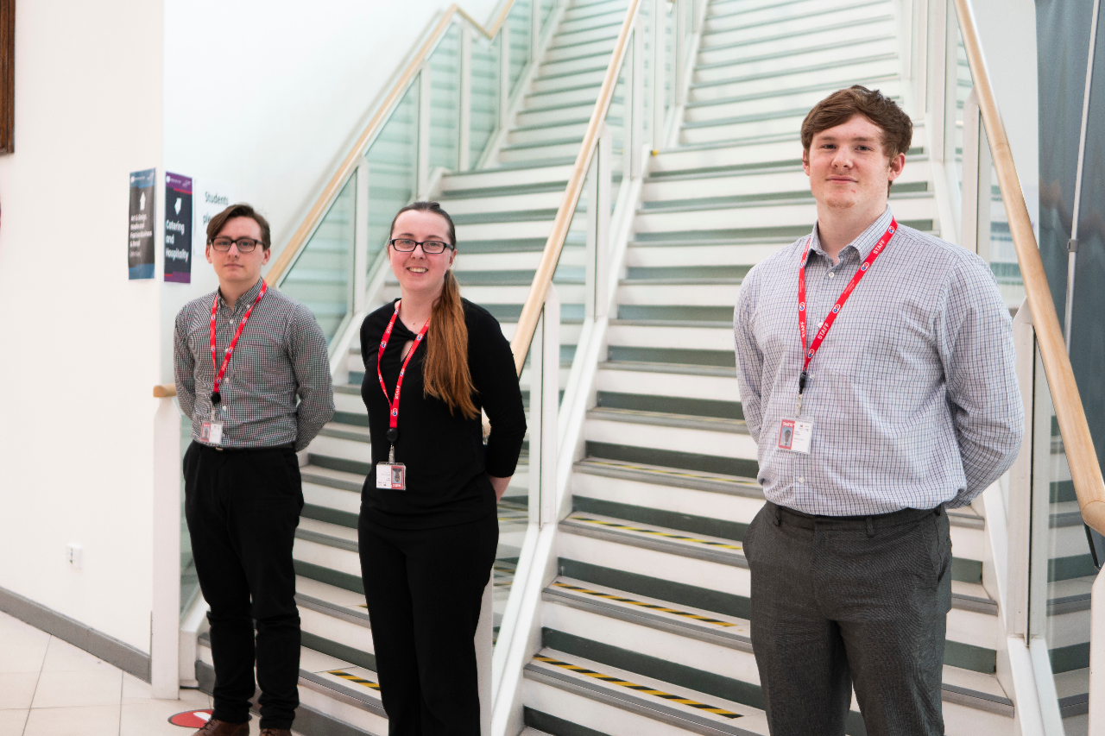
Digital Coaches
Notes:
RS

Slide 52
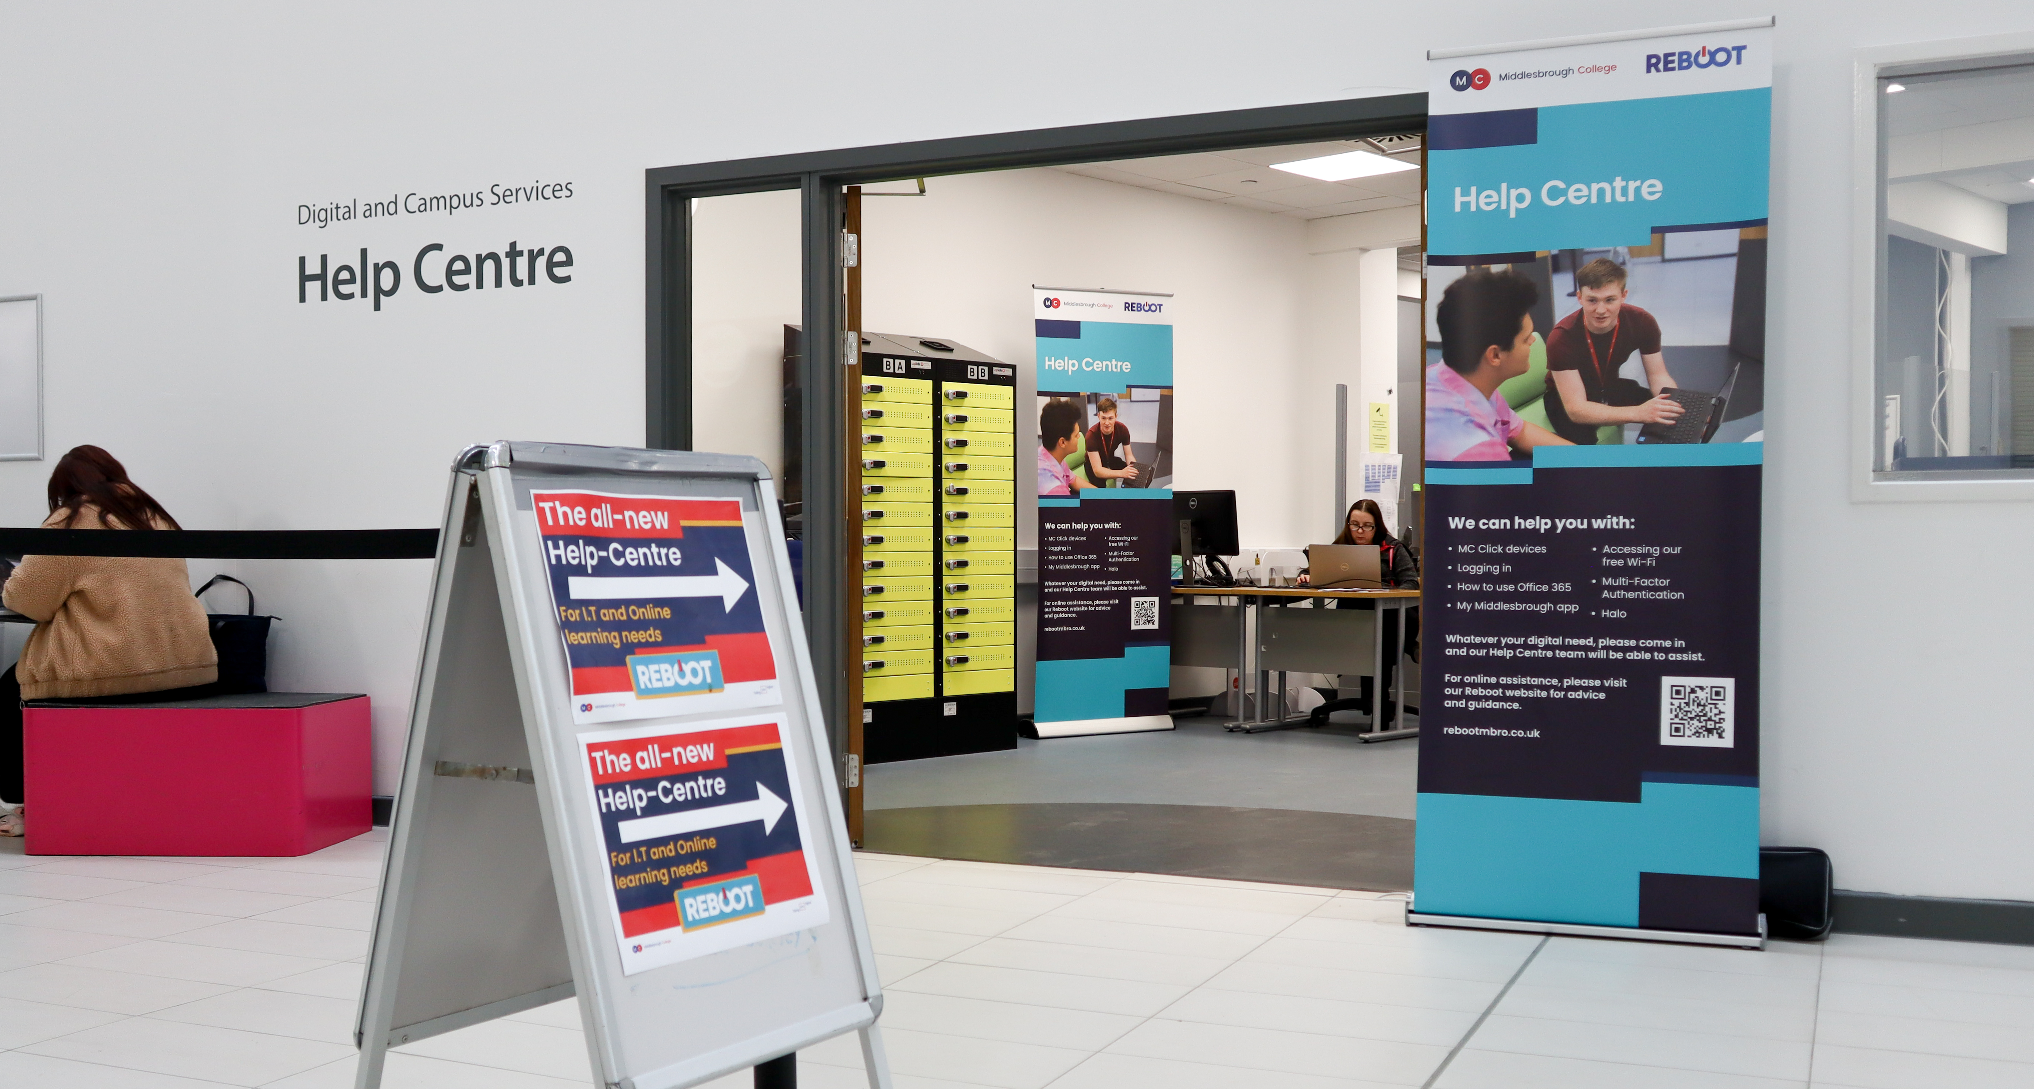
Notes:
RS

Slide 53
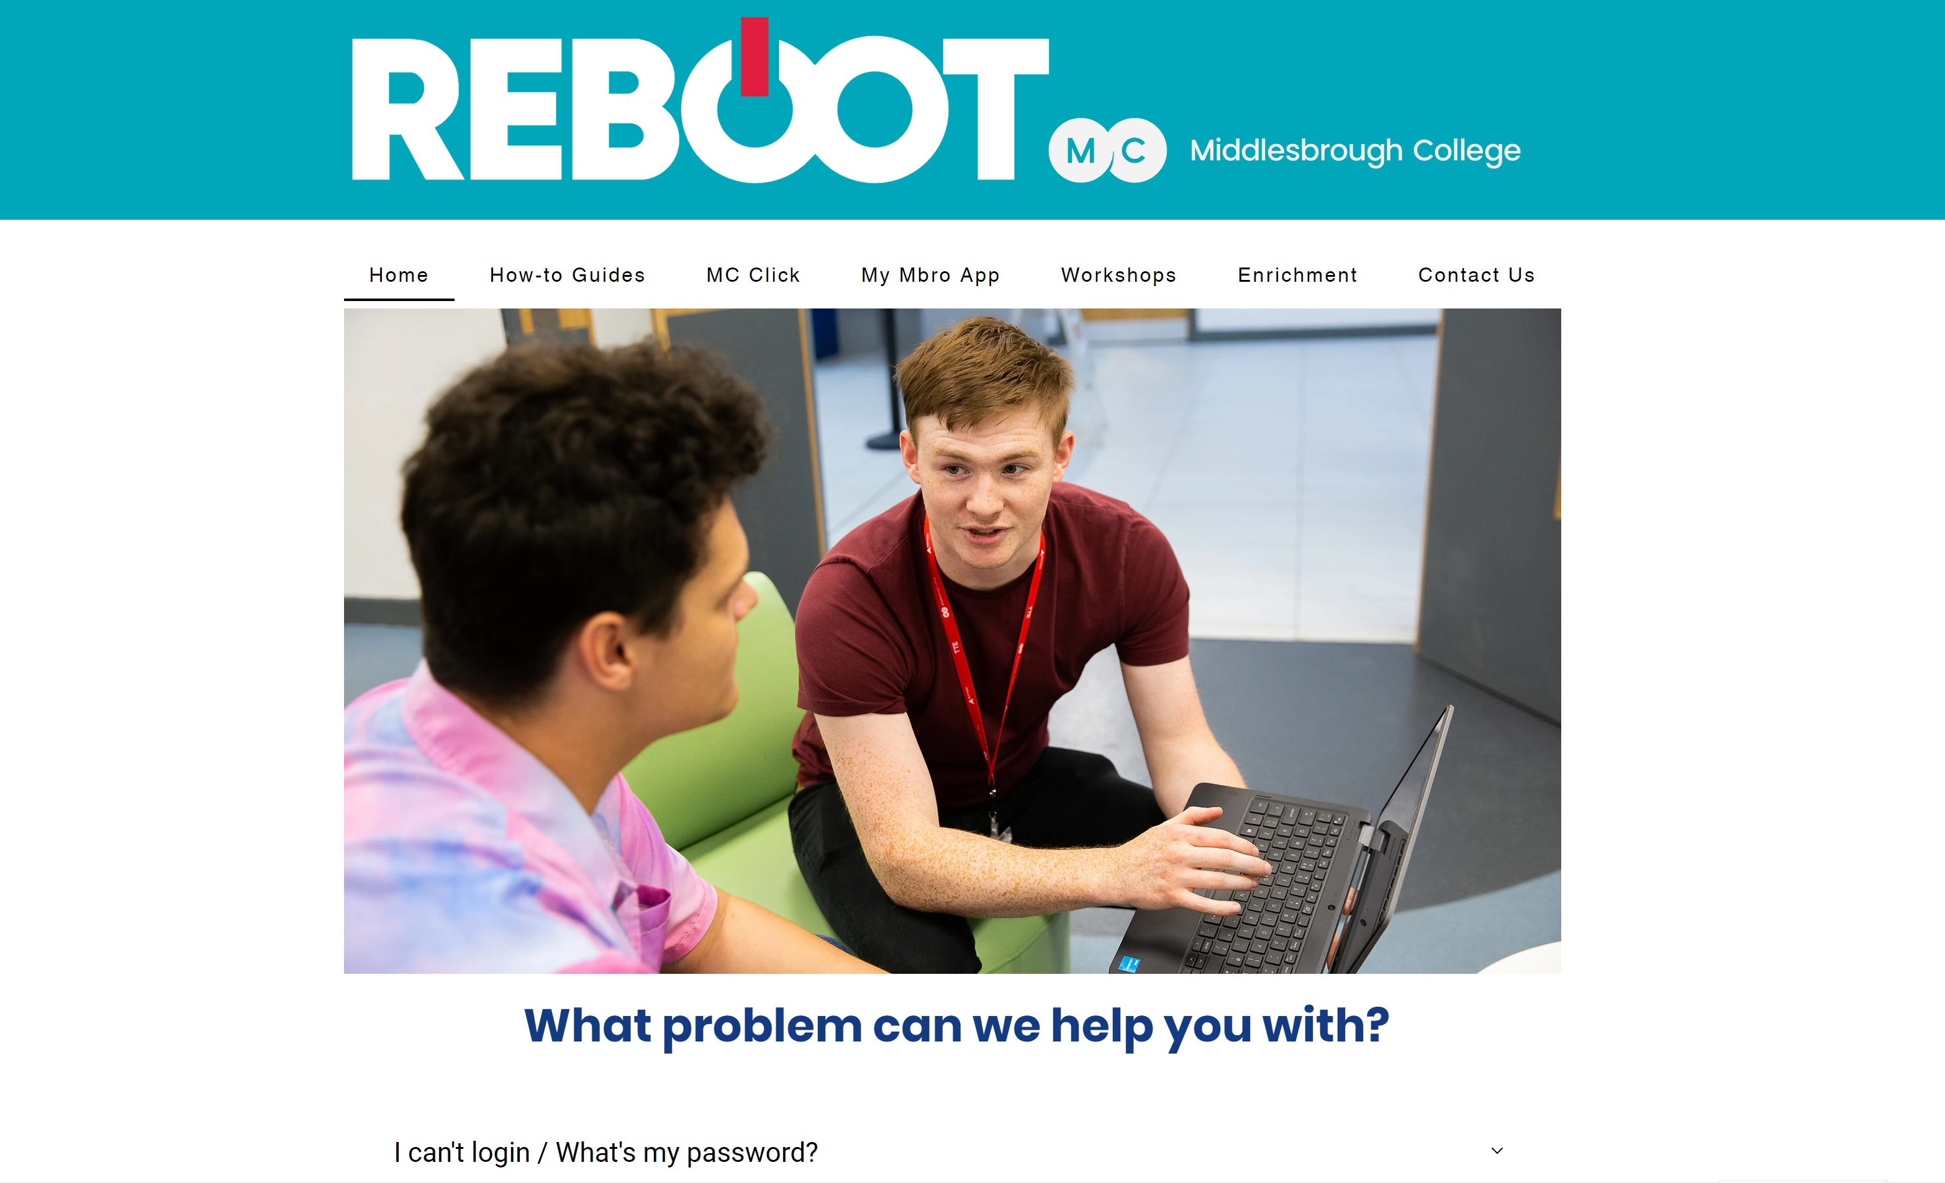
Notes:
RS

Slide 54
Notes:
RS

Slide 55
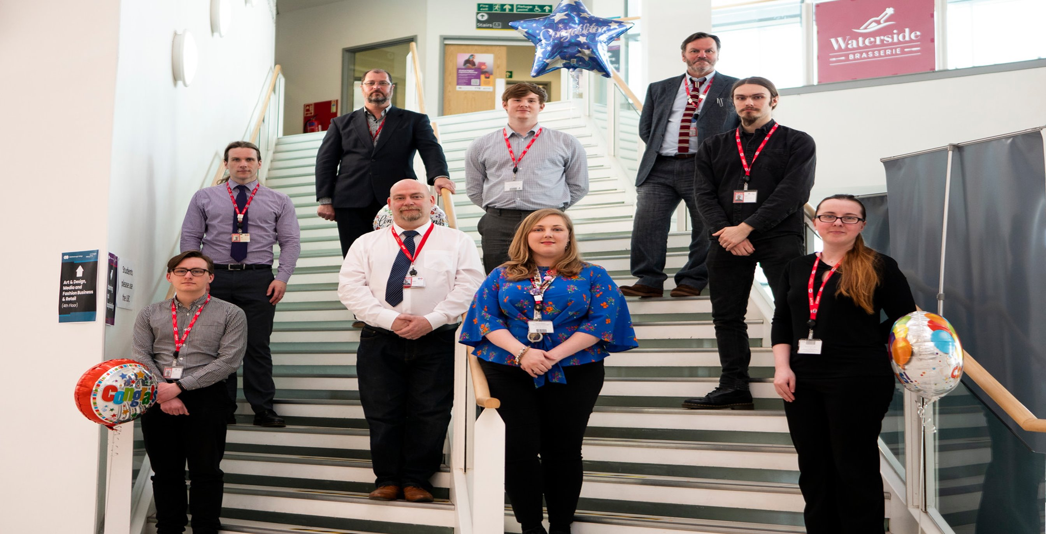
Digital Champions
Overview: Appointed 20 digital champions in departments
Impact: Improved communication, feedback and training
MC Click
Challenges: Timetabling
Notes:
RS

Slide 56
Digital Requirements
Improved access to digital
Improved training and support
MC Click
Fewer, more intuitive systems
Notes:
RS

Slide 57
VLE Rationalisation
Overview : Move from using 4 VLE solutions to 1
Impact : Improved support, training, QA, communication
Challenges: Individual preferences
Notes:
JW

Slide 58
Digital Requirements
Improved access to digital
Improved training and support
MC Click
Fewer, more intuitive systems
Notes:
RS

Slide 59
Next Steps
Notes:
JW & RS

Slide 60
Next Steps
MC Click V2.0
Teams Telephony
SharePoint Online Intranet & Storage
MC Click
Internet for all?

Slide 61
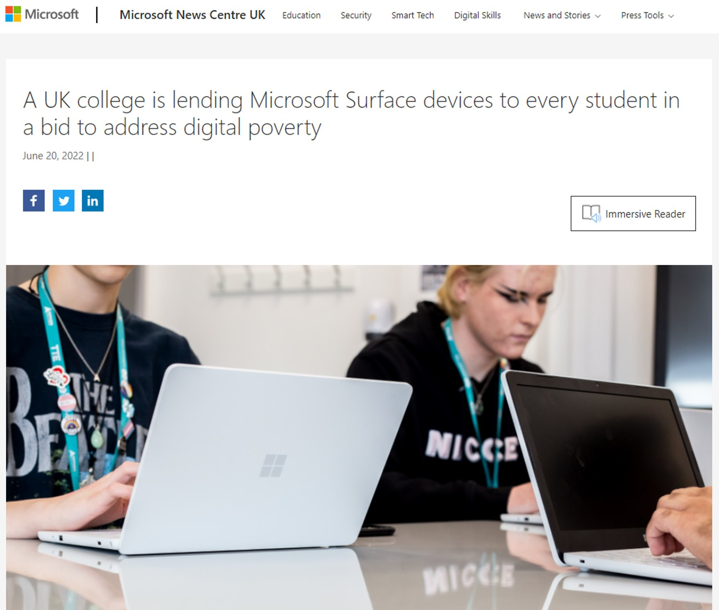

Slide 62
Next Steps
MC Click V2.0
Teams Telephony
SharePoint Online Intranet & Storage
MC Click
Internet for all?

Slide 63
Transformation
Equality and digital accessibility for all learners
Highly employable learners
Enhanced business productivity
Innovative digital education

Slide 64
For more information please contact
James Wells
Director : Digital Innovation & Support
Middlesbrough College
E: jb.wells@mbro.ac.uk
T: 01642 333511
In:
Name
Job Title
Organisation
Email Address
Telephone Number

